Slide 1
Frequency Domain Analysis
Lecture 6

Slide 2
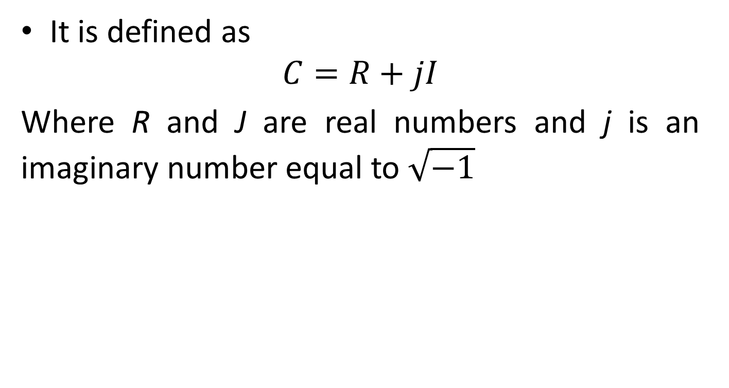
Complex Numbers
It is defined as
$$C=R+jI$$
Where R and J are real numbers and j is an imaginary number equal to $\sqrt{−1}$

Slide 3

Fourier Series

Slide 4
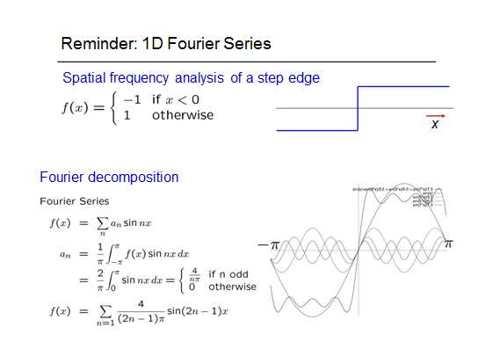

Slide 5
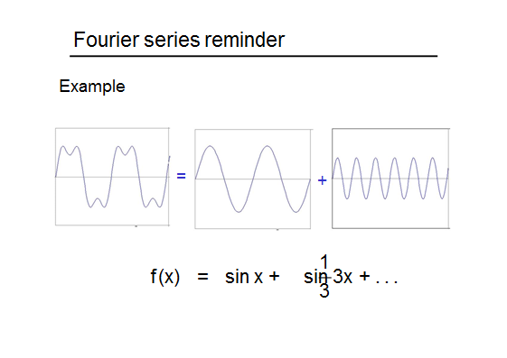

Slide 6
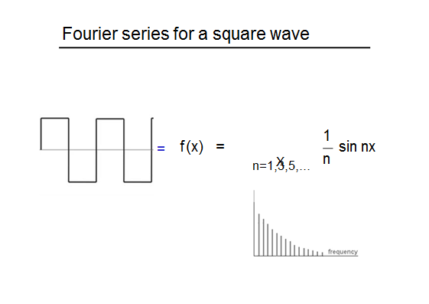

Slide 7
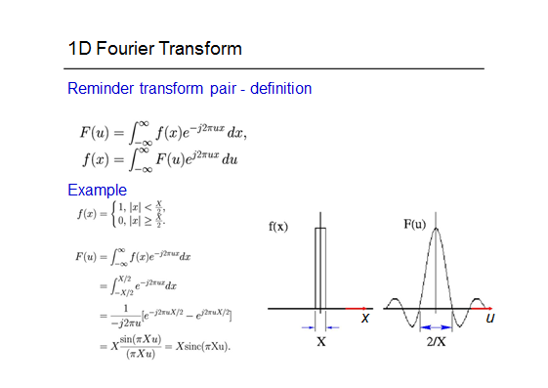

Slide 8
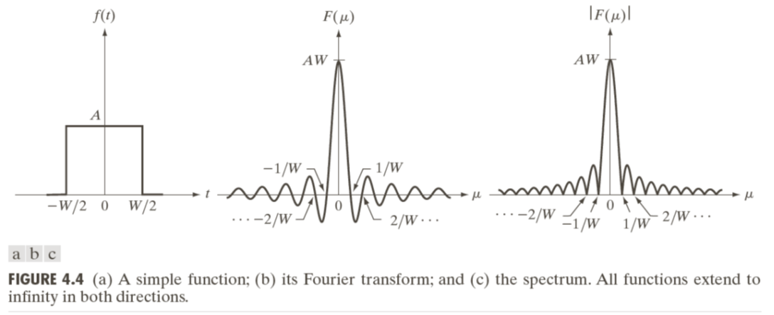
In Fourier transform, we work with the magnitude of the
transform also called as the Fourier spectrum or frequency spectrum

Slide 9
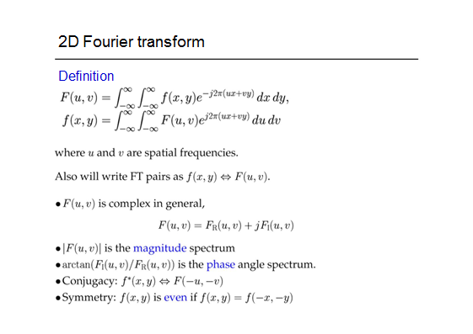

Slide 10
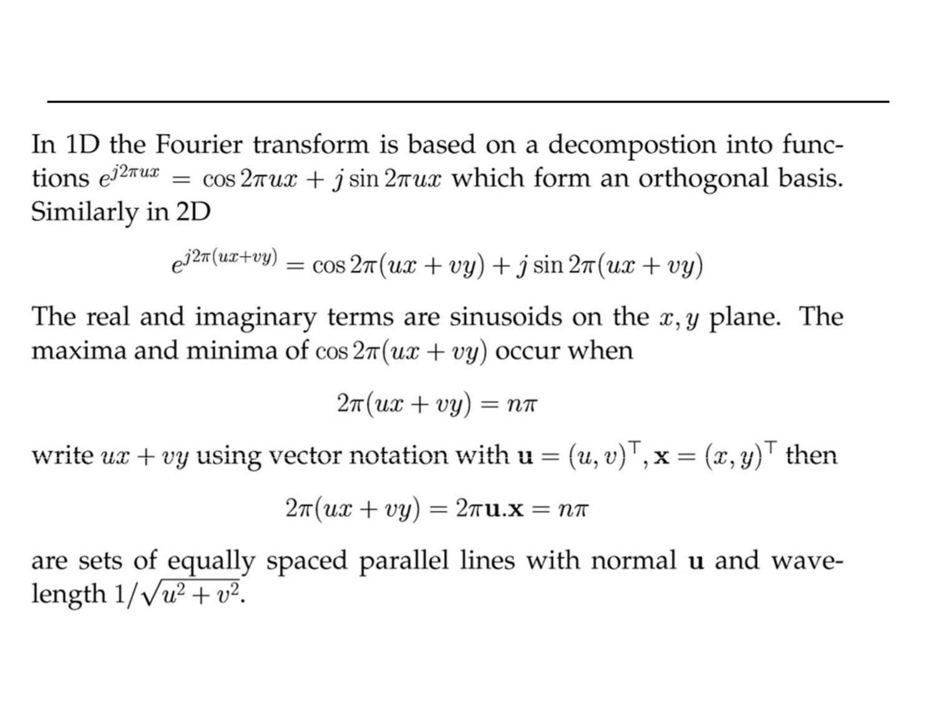

Slide 11
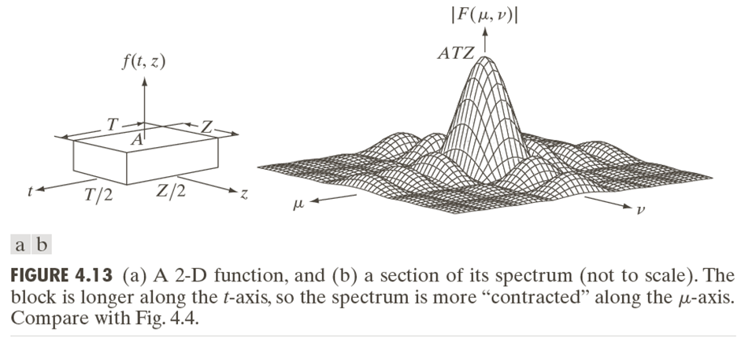

Slide 12
Some important Fourier Transform Pairs

Slide 13
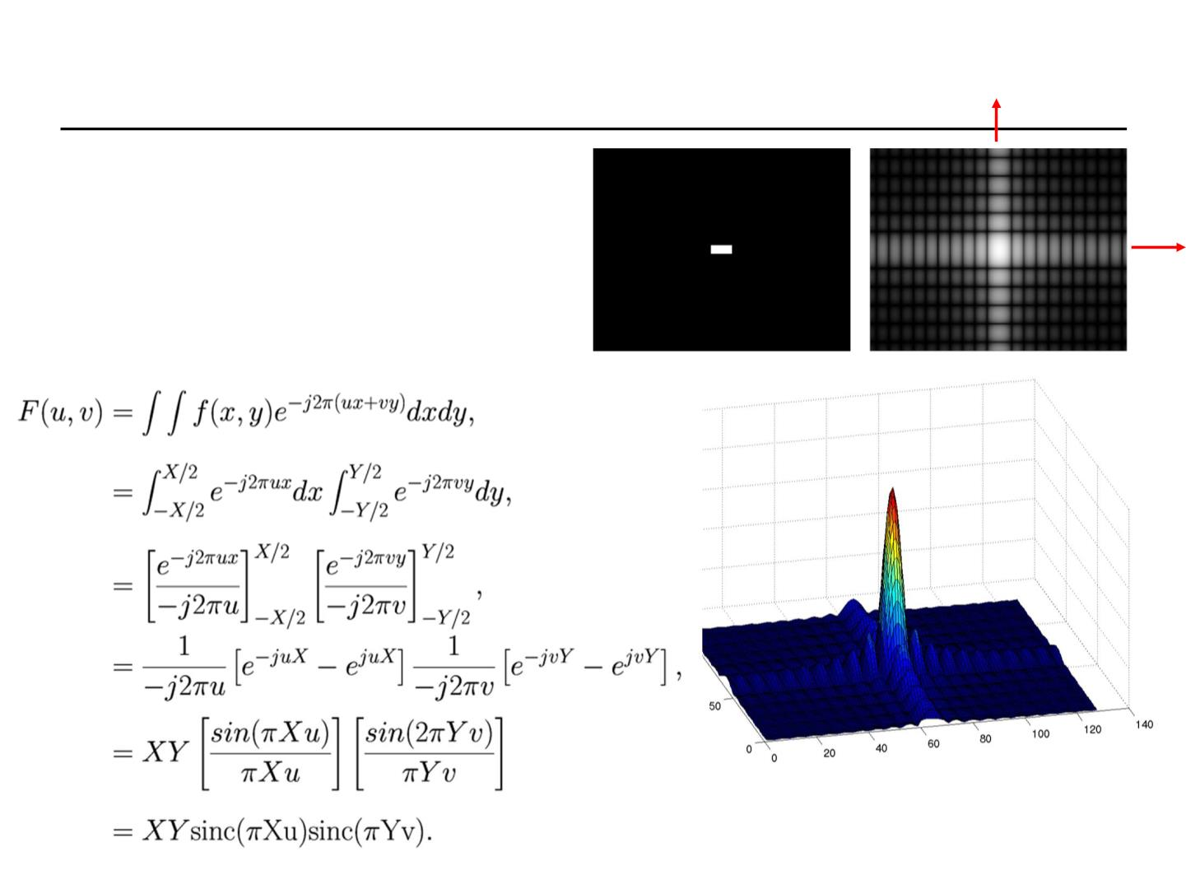



Slide 14
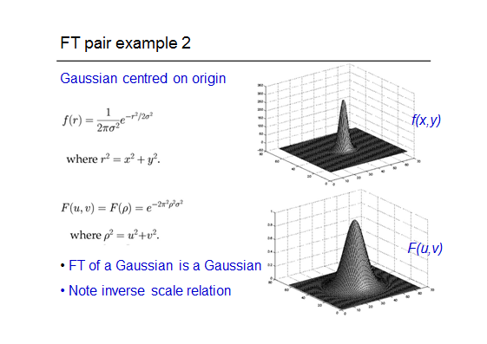

Slide 15
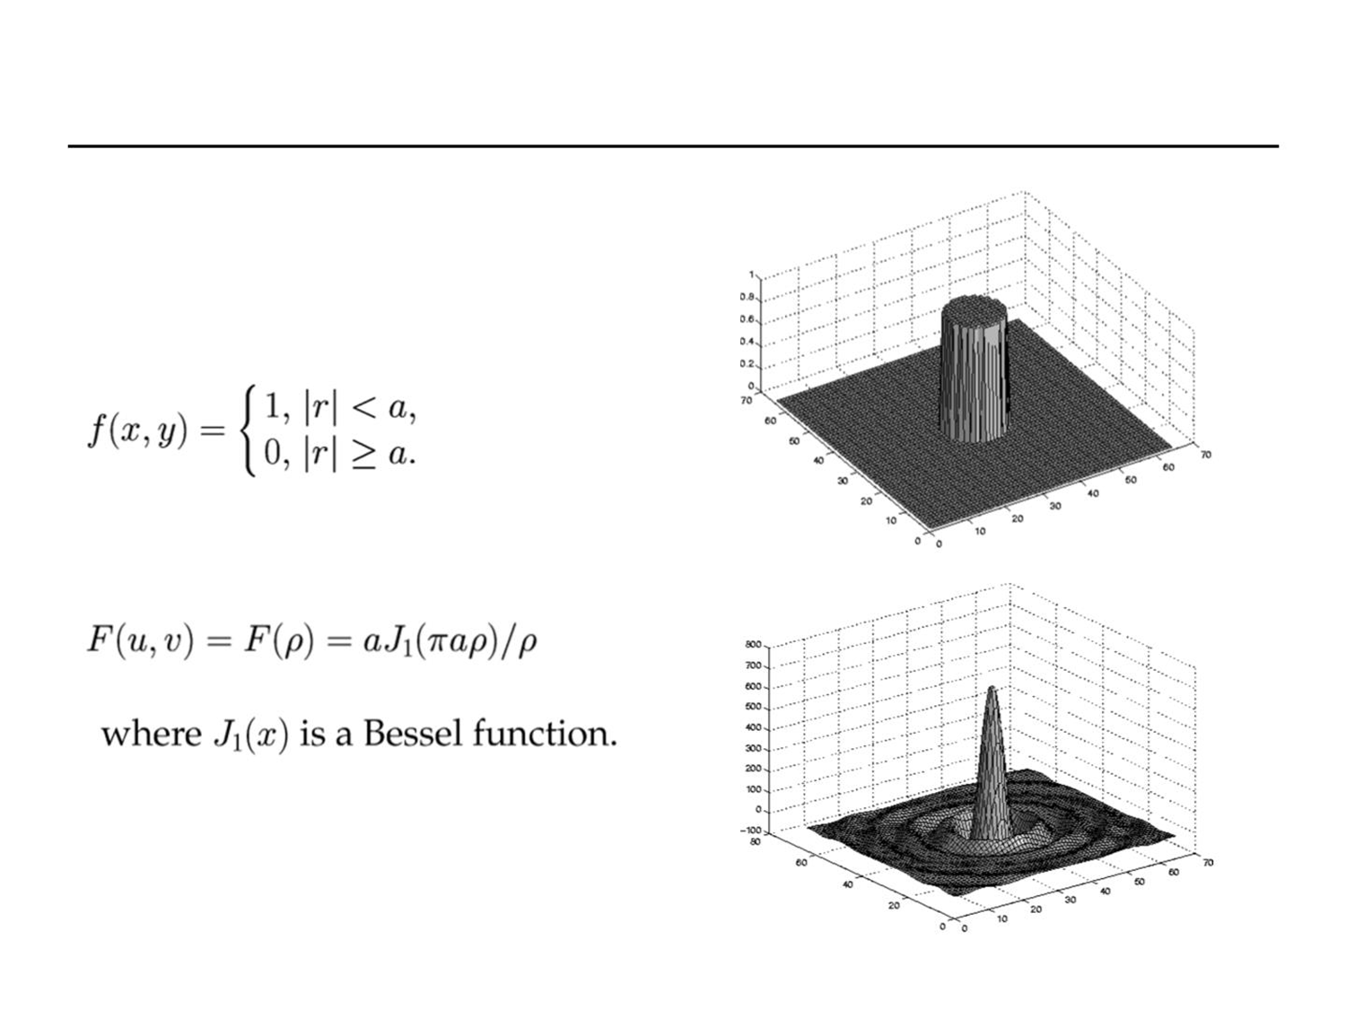
Circular disk unit height and
radius a centered on origin
a ‘2D’ version of a sinc

Slide 16
Introduction to Transforms
The term frequency in an image tells about the rate of change of pixel values
We first transform the image to its frequency distribution
Processing is done on the transformed image
After performing inverse transformation, it is converted into an image which is then viewed in spatial domain

Slide 17
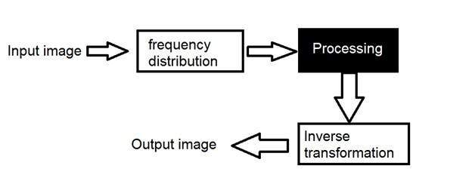
Pipeline

Slide 18
Types of frequency transformations
A signal can be converted from time domain into frequency domain using mathematical operators called transforms.
There are many kind of transformation some of them are :
Fourier Series
Fourier transformation

Slide 19
Frequency Components
Frequency components are divided into two major components:
High frequency components- correspond to edges in an image
Low frequency components- smooth regions in an image

Slide 20
FT in Image Processing
The Fourier Transform is an important image processing tool which is used to decompose an image into its sine and cosine components
The output of the transformation represents the image in the Fourier or frequency domain, while the input image is the spatial domain equivalent

Slide 21
DFT
The components of the spectrum of the DFT determine the amplitudes of the sinusoid that combine to form the resulting image
At any given frequency in the DFT of an image a large amplitude implies a greater prominence of a sinusoid of that frequency in the image
A small amplitude implies a less of that sinusoid is present in the image
The phase is a measure of the displacement of the various sinusoids with respect to the origin

Slide 22
DFT
Magnitude of the 2D DFT is an array whose components determine the intensities in the image
The corresponding phase is an array of angles that carry information about where discernable objects are located in the image

Slide 23
How to interpret the frequency domain image
The output frequency domain image tells us how much each frequency component is included in the original image
Pixels near the center represent lower frequency components, and outer side pixels represent higher frequency component
Thus, if pixels near the center are brighter than others outer side, this means that the original image is composed with lower frequency components more than higher frequency components

Slide 24
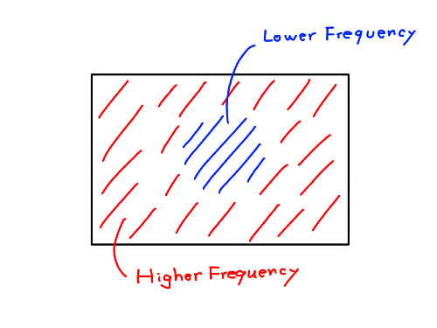
How to interpret the frequency domain image

Slide 25
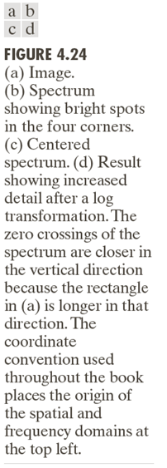
Example of DFT on image

